Slide 2
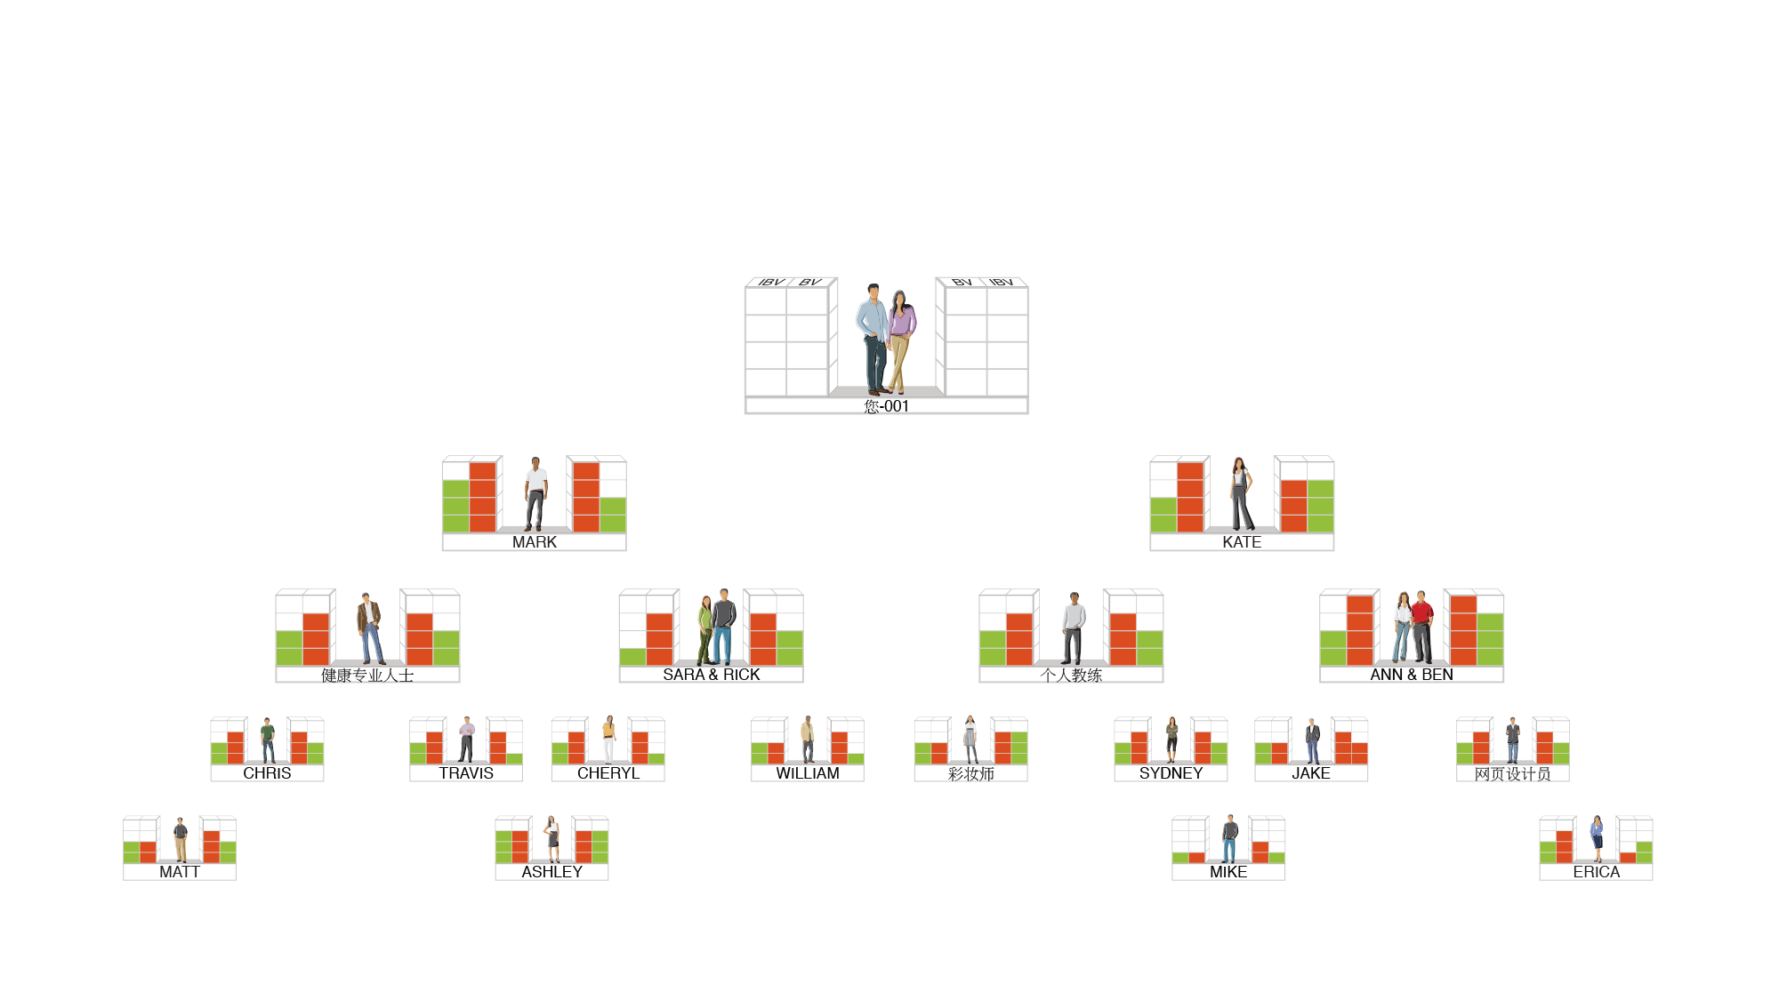
AS YOUR ORGANISATION EXPANDS
The frequency of commissions earned increases until it occurs weekly
5000 / 5000 = S$750
3600 / 3600 = S$375
2400 / 2400 = S$375
1200 / 1200 = S$375
S$1,875
5000 / 5000 = S$750
3600 / 3600 = S$375
2400 / 2400 = S$375
1200 / 1200 = S$375
S$1,875
BV
5000
5000
IBV
3600
3600
2400
2400
1200
1200
TOTAL WEEKLY POTENTIAL S$3,750 PER BDC

Slide 3
My personally sponsored partners – SC and above

Slide 4
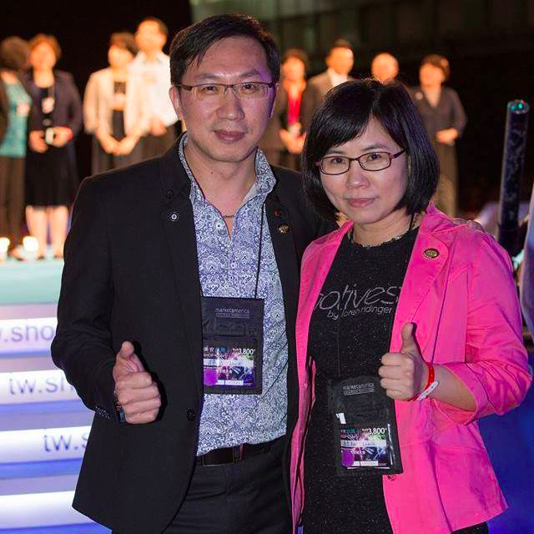
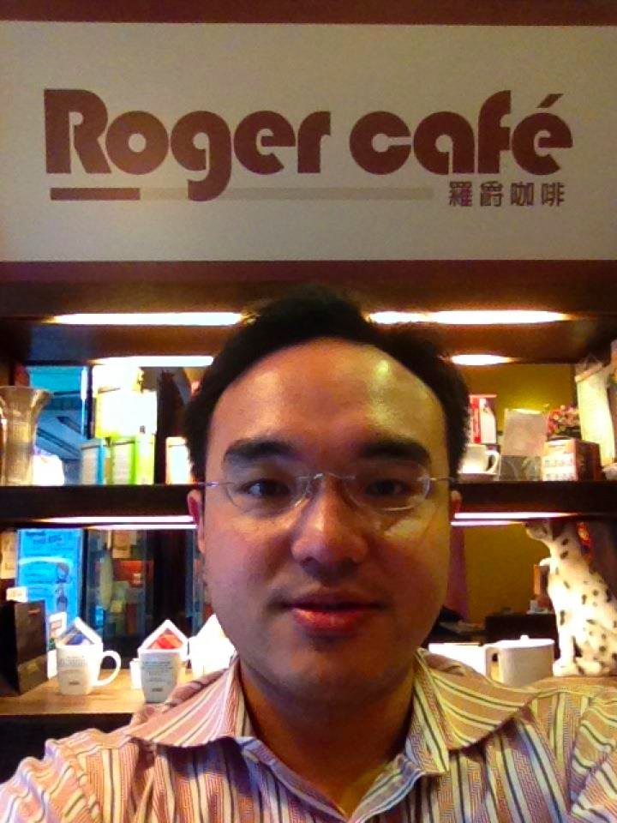
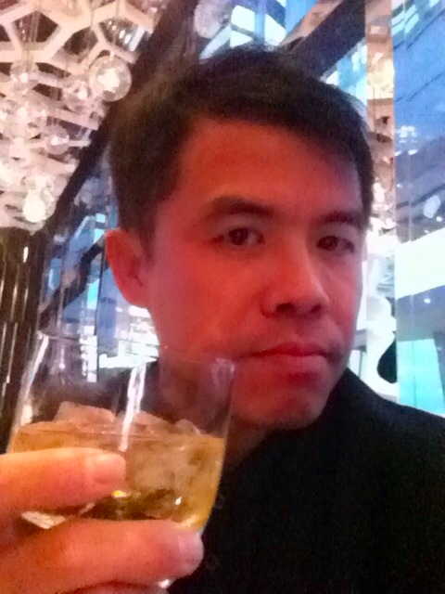
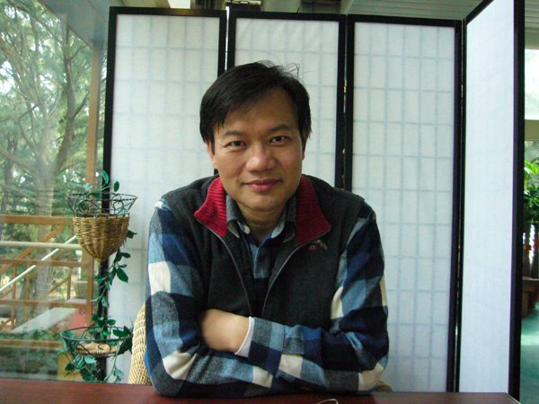
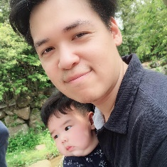
Director
Executive
Director
潘镜允&黄麟翔
蔡昌志&林孟涵
NSC
林育世
吴辉荣
彭国定
黄世桦
SC
侯妏蒨
張鈞捷

Slide 5
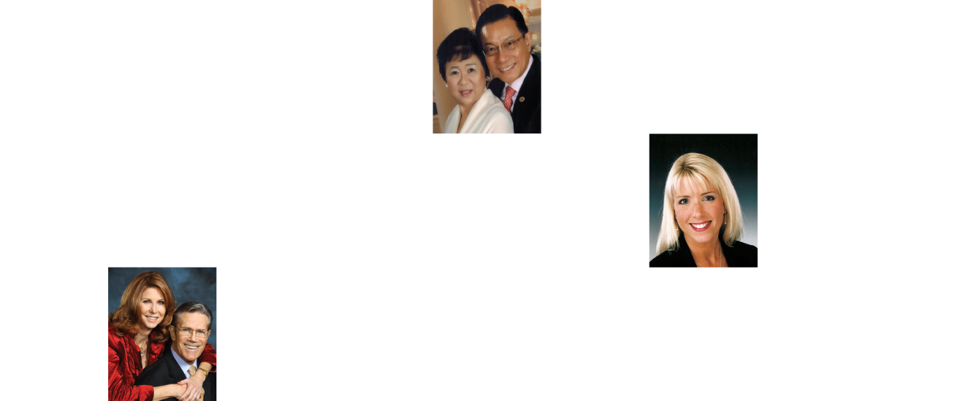
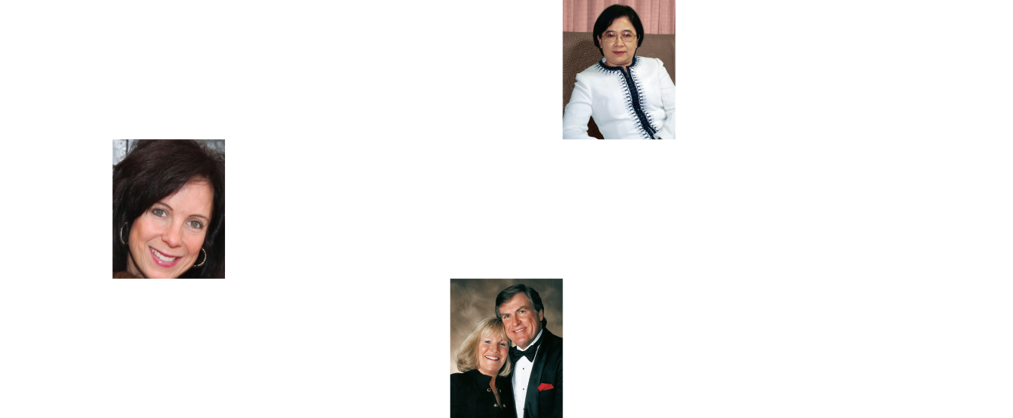
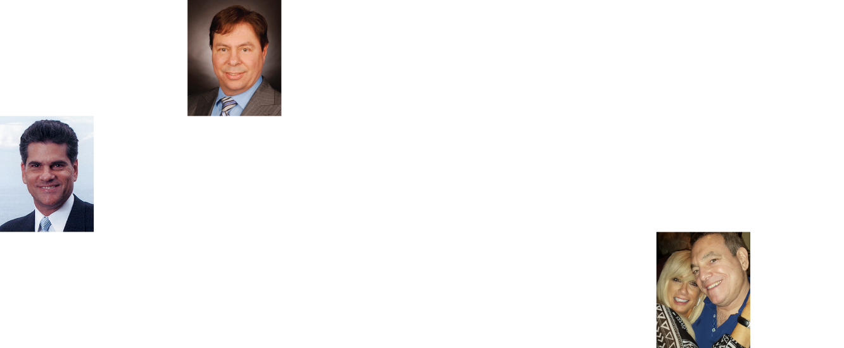
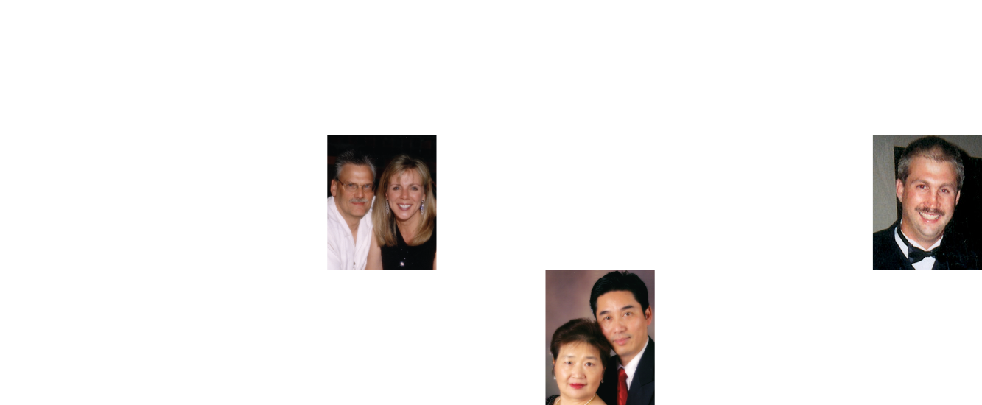
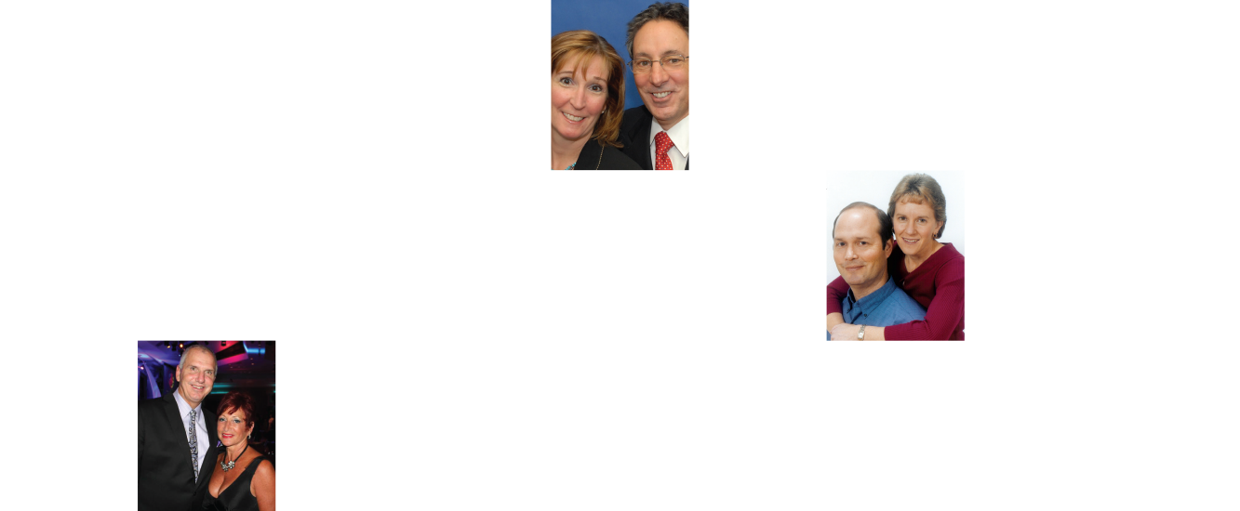
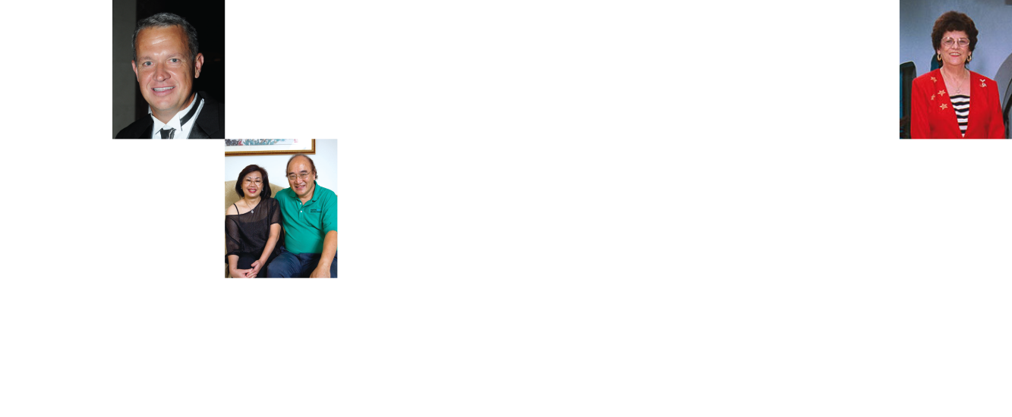
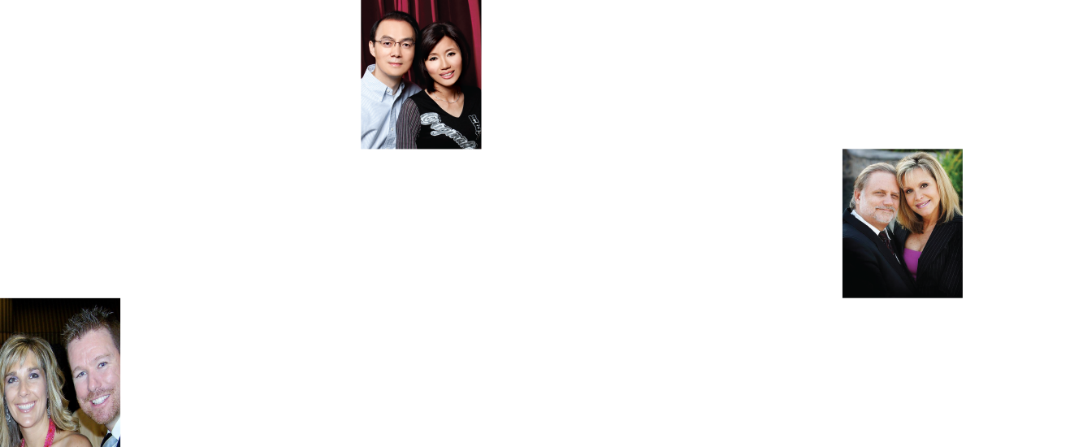
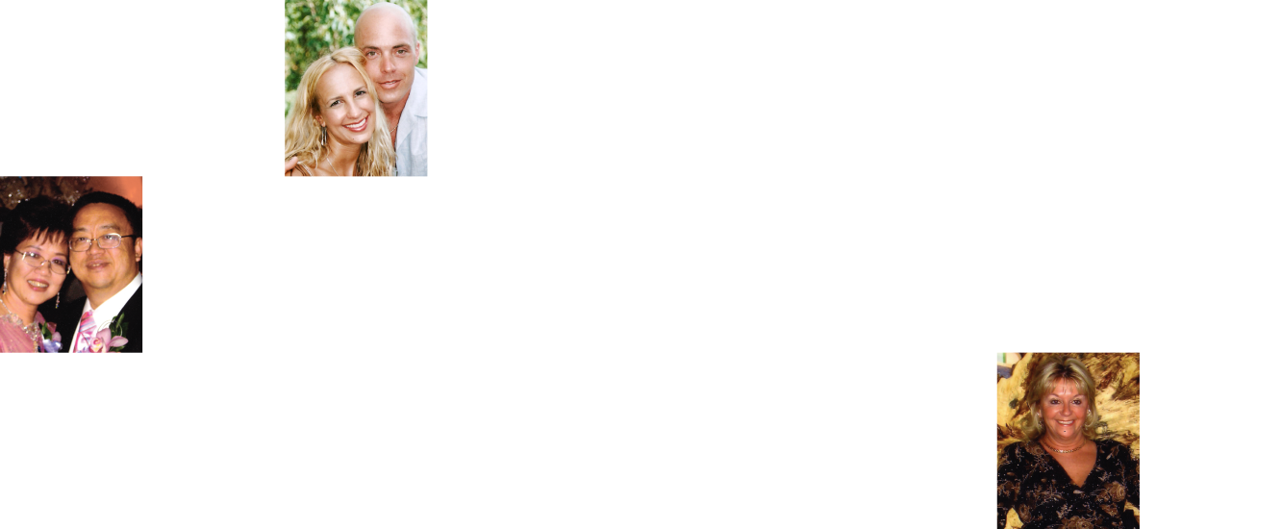
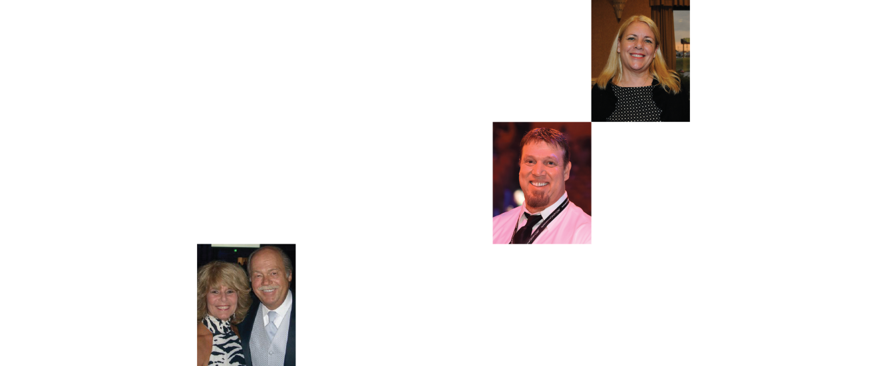
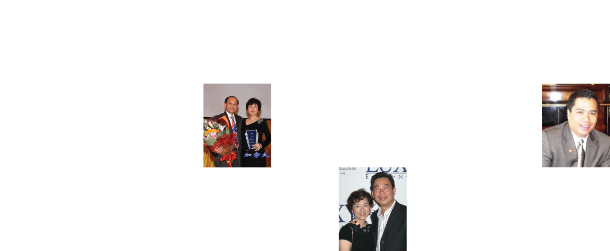
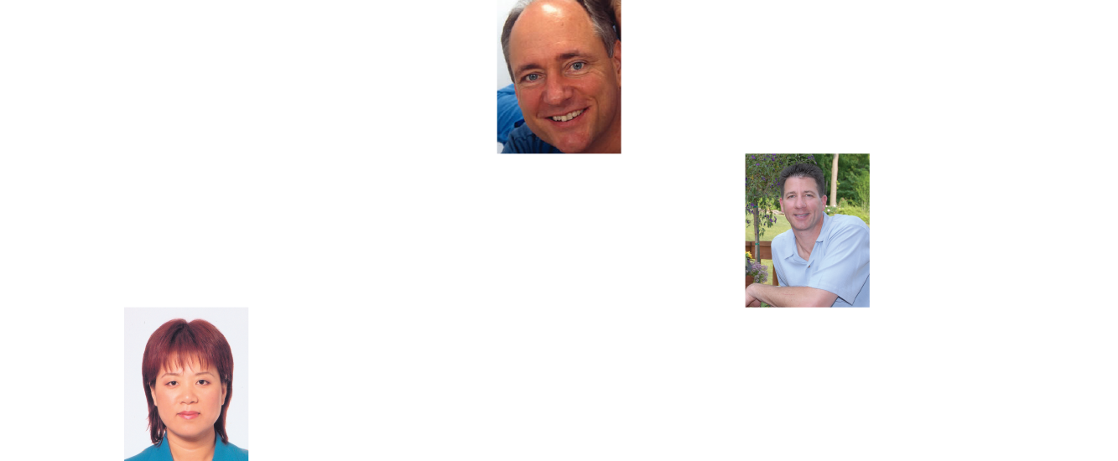
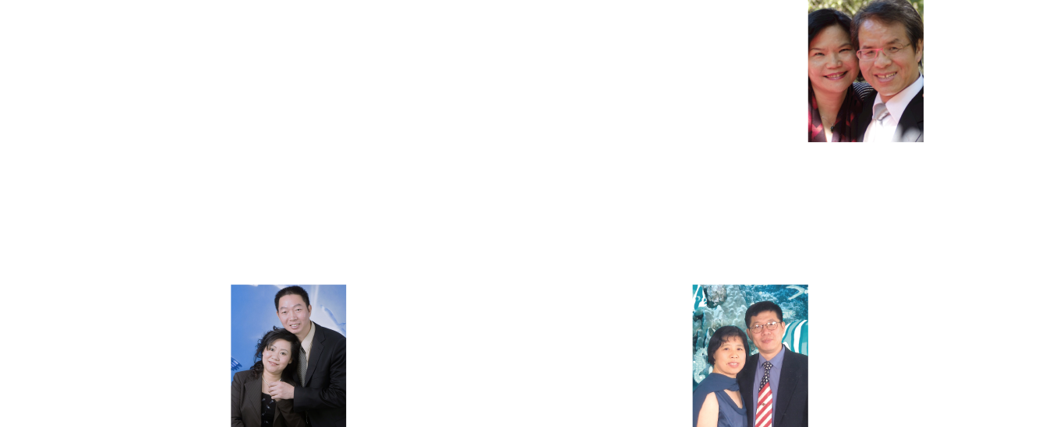
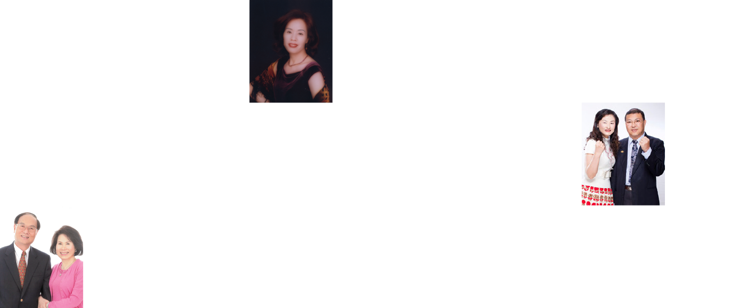
EARNED OVER ONE MILLION DOLLARS IN COMMISSIONS
MARKET SINGAPORE® | SHOP.COM™ IS CHANGING THE WAY THAT PEOPLE SHOP SO EVERYONE CAN BECOME FINANCIALLY INDEPENDENT BY CREATING THEIR OWN ECONOMY

Slide 6
FOR ThREE MINUTES ON THE STAGE
TEN YEARS OF HARD WORK

Slide 7
TWO MINUTES COMMERCIAL

Slide 8
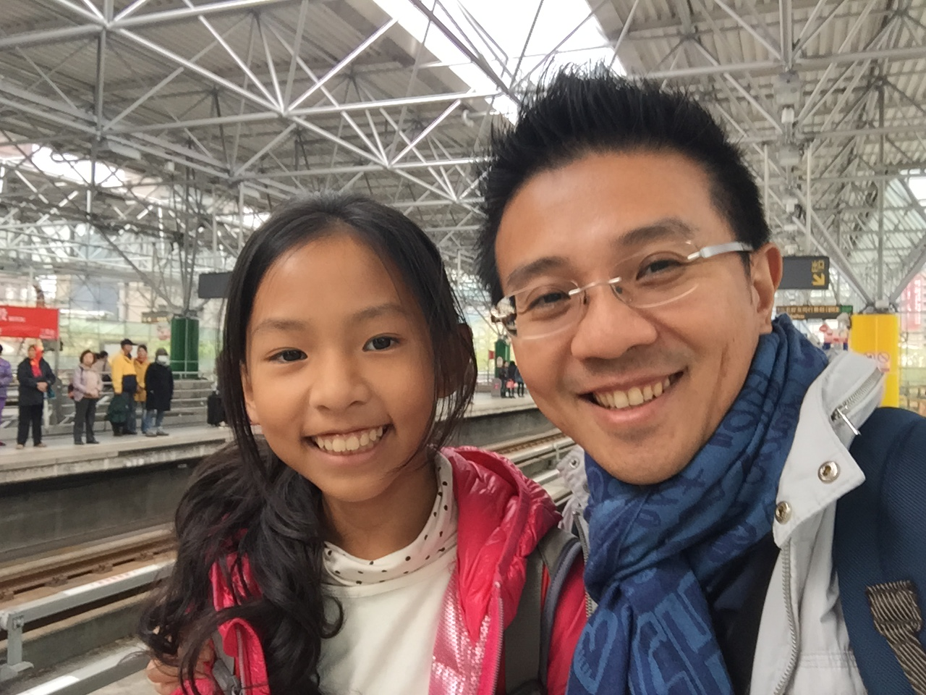
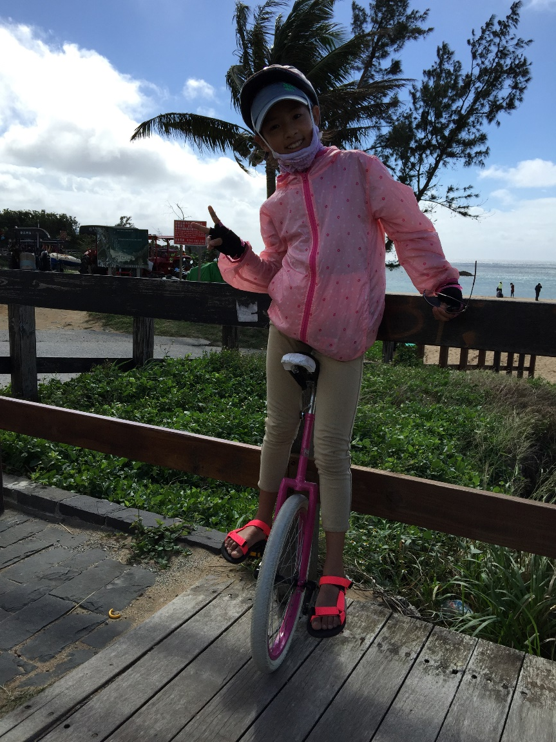
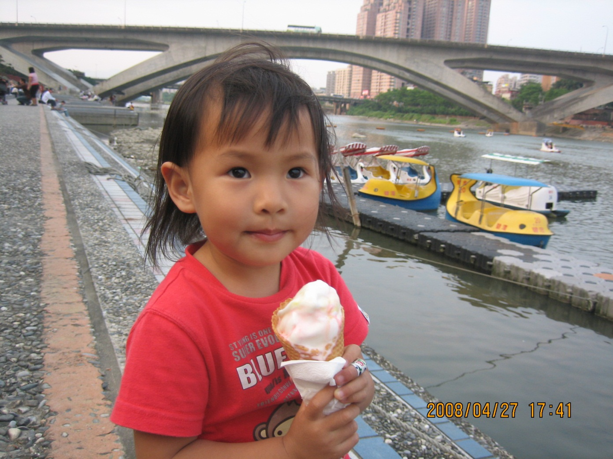
The Initial two minutes commercial…

Slide 9
COMPANY
PRODUCTS
SYSTEM

Slide 10
REAL BELIEF VS FALSE BELIEF
TO BE SERIOUS
VS TO HAVE FUN

Slide 11
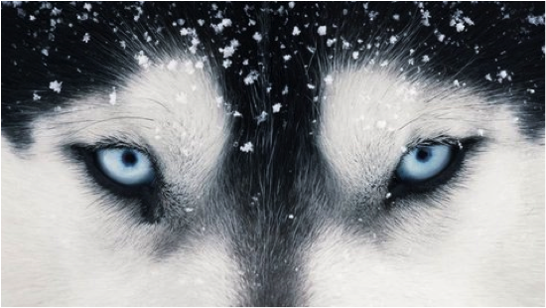
Spirit of a Wolf

Slide 12
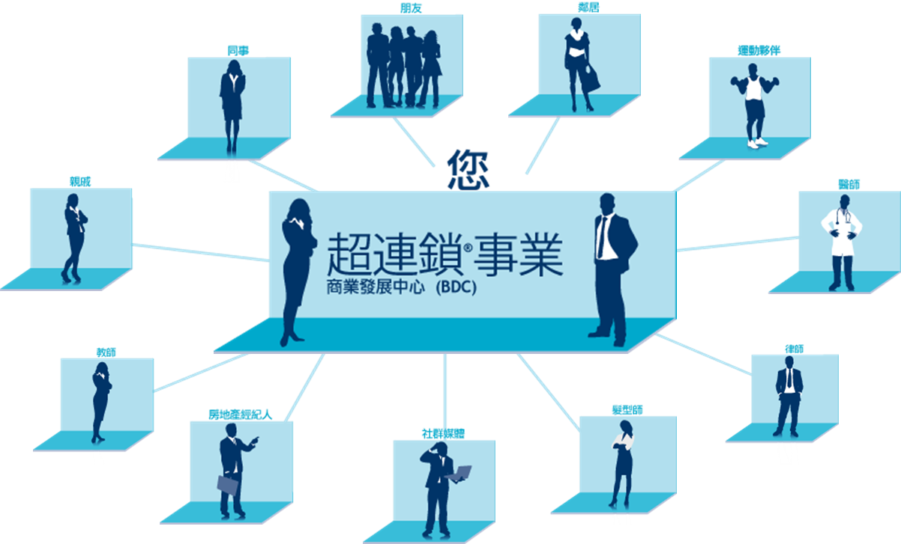
Strongly Recommended Market America’s Business Strategy
Focus on establishing 30 Preferred Customers, one month after starting your business.
In the process, you will strength your knowledge and retailing, thereafter you may begin recruiting, your team will greatly multiply!

Slide 15
One minute sales person?
Ability to provide
Valuable information

Slide 16
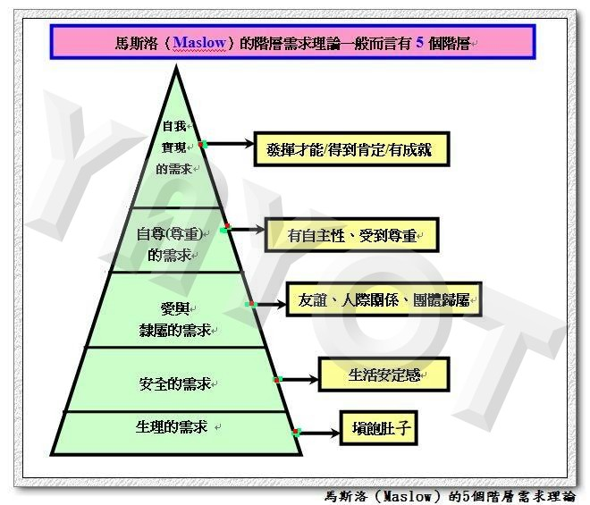
MASLOW HIERACHY OF NEEDS
EVERYONE CAN BE RECRUITED
EVERYONE HAS NEEDS
RIGHT TIME, RIGHT PLACE, RIGHT PEOPLE

Slide 17
振頻比你低的：會評判你、攻擊你、否定你。
唯有振頻比你高的：會知你、懂你、愛惜你、慈悲對待你。
原文網址：https://kknews.cc/essay/qy6py2y.html
振頻比你低的：會評判你、攻擊你、否定你。
唯有振頻比你高的：會知你、懂你、愛惜你、慈悲對待你。
原文網址：https://kknews.cc/essay/qy6py2y.html
振頻比你低的：會評判你、攻擊你、否定你。
唯有振頻比你高的：會知你、懂你、愛惜你、慈悲對待你。
原文網址：https://kknews.cc/essay/qy6py2y.html
Resonance with the frequency
People with the same frequency：will like you, praise you, affirm you, protect you, love you
People whose frequency are lower than you：will judge you, attack you, deny you
Only people with higher frequency than you：will understand you, love you, treat you with compassion.

Slide 18
What is Recruitment process (steps)?
1.Name List
2.Call
9. Enrol
3. Initial Meeting
SYSTEM
8.Coring
4.HBP
7.Problems
6.GMTSS
5.UBP

Slide 19
Only a glowing candle can light another candle

Slide 20
If you are aware, everything in your surroundings will bring you knowledge.
If you are not aware, then even the most valuable knowledge has no meaning.
~Indian wise man Gurudev ~

